Slide 1
Evaluation of an online community formed by Australians with type 1 diabetes
Kate Gilbert
AES Conference, Sydney, 31 August 2011

Slide 2
The Evaluand: ‘Reality Check’
Online community - Type 1 diabetes
12 years old
1,558 registered members
Accredited by Health on the Net
Six volunteer moderators
Rules: share experiences not medical advice
Peer support program

Slide 3
Type 1 Diabetes
Neither preventable nor curable
Can occur at any age
Complex daily management by patient includes:
calculating and adjusting insulin doses
testing blood glucose levels
treating hypoglycaemic events
administering insulin injections
counting carbohydrate content of all food

Slide 6
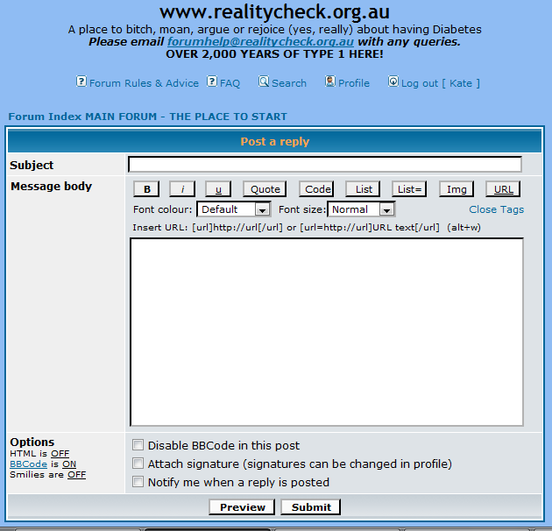

Slide 7
Evaluation Objectives
1. Provide information to the managers of the program to assist them improve it, increase its reach and understand what key stakeholders most value about it 2. Contribute to the growing field of peer support research experiences from this long-standing, peer-led and self-sustaining program

Slide 8
Literature Review: Peer Support
(Fisher, 2010)
Four ‘core functions’ of peer support:
Assistance in applying disease management in daily life
Emotional and social support
Linkage to clinical care
Ongoing and proactive support (Boothroyd & Fisher, 2010)
Benefits include clinical improvements (Heisler, 2006; WHO, 2008), promoting complex health behaviours (Elstad, 2010)

Slide 9
Literature Review: Evaluation Approach
Developmental perspective
Pluralistic Approach
Value Explication – Success Values (Øvretveit)
Internal evaluator – Owen’s (2006) guidelines

Slide 10
Lit Review: Online Research Methods
Content analysis common (eg. Lasker et al 2005)
Reach: “bias in results is too great and too multiplicitous to give value to estimations of the reach” (Burns et al, 2008)
Lithium Technologies (2009) internal health factors
Online focus groups. Benefits: flexibility, time to reflect (Stewart & Williams, 2005; Walston and Lissitz, 2000)
Ethical conduct - no consensus (Gaiser and Schreiner, 2009), observing online activities for research, without informed consent, may be unethical (Lawson, 2004)

Slide 11
Lit Review: Evaluating Peer Support
WHO (2008): “peer support programs should be evaluated objectively, and results [be] used to guide further service improvement”
Fisher (2010) and Hawe et al (2008) on complex interventions: functions separate from content or specific local delivery methods

Slide 12
Evaluation Approach
Developmental perspective
Pluralistic evaluation approach
Prioritised stakeholders' values and sought divergent views.
An internal evaluator was used - resulting ethical issues addressed.

Slide 13
RESEARCH METHODS

Slide 14
Methods
Planning and Engagement:
Ethics approval
Ethical issues with internal evaluation
Estimating Reach through Website Use Data
Content Analysis - one week snapshot
Online Focus Groups – independent facilitator
Health Professional Survey – online, anonymous
Program Managers Workshop
Notes:
Both focus group data and health professional survey used three stage thematic analysis: immersion > codes > categories (Green et al, 2005)
Two independent coders

Slide 15
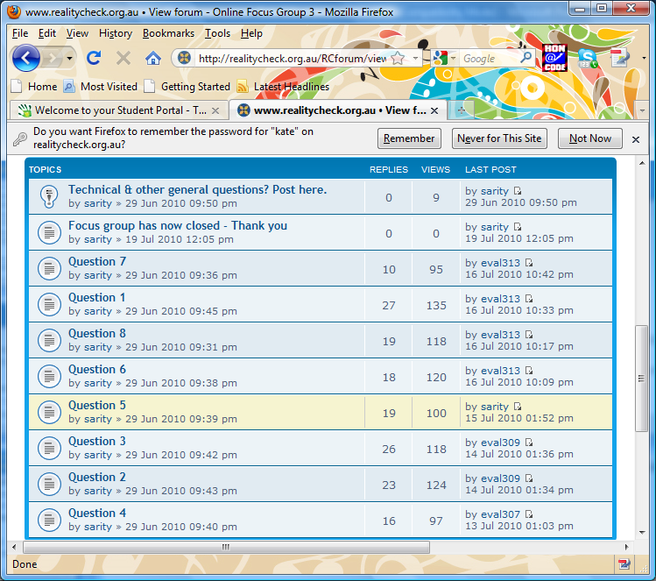
Online Focus Group example

Slide 16
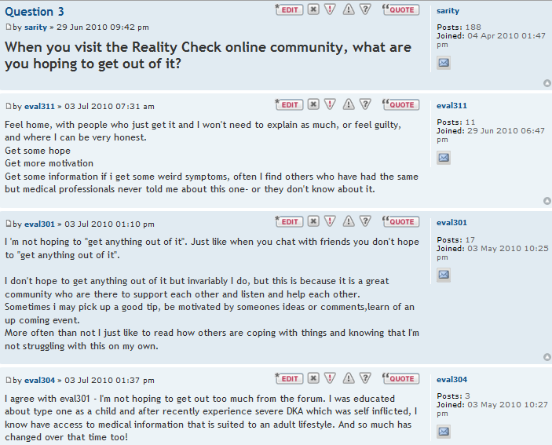

Slide 17
KEY FINDINGS

Slide 18
1. Reach & Content Analysis
311 active participants in last 6 months = only 20% registered members
Unknown number of ‘observers’
Content analysis: 23 topics discussed
Internal ‘health’ (Lithium Technologies, 2009)
Interactivity: 15 messages / discussion thread
Responsiveness: median 1 hour: 14 minutes response time
New members : 11/week : 7 never contributed after 3 months

Slide 19
2. Online Focus Groups
6 focus groups - over 2 weeks
41 participants
Mean age 37.2 years (range: 22 - 60 years)
26% male
Diabetes duration – mean 17.5 years, (1-46 years)
39 (93%) resided Australia, 2 (5%) UK; 1 (3%) NZ
Grouped by common patterns of usage
Notes:
6 focus groups, conducted over two weeks, formed by common patterns of use of the website = observers, occasional through to frequent participants- minimal variations in age and gender between groups

Slide 20
2. Online Focus Groups: Success Values
Peer Support definition (Boothroyd and Fisher, 2010)
Core component | Subcategories from definition | New subcategorIes
1. Acceptability of program delivery features | Not defined | Sizeable, active and diverse community Active and effective management Open access online delivery Local relevance Peer-led
2. Assistance in applying diabetes management in daily life | Real life experiences of living with diabetes Identifying key resources | Problem solving Learning Improve management of diabetes
3. Social and emotional support | Empathetic listening Encouragement Stay motivated Coping with social and emotional barriers | Feel supported Self-reflection Connection & interaction with peers Sense of community Assist others
4. Ongoing , proactive support |  | No sub-categories
Notes:
Surprising that success values so clearly aligned with the definition of peer support, especially given this was an online program and the definition developed out of offline ‘in-person’ peer support programs
Surprising that even though online in fact deeper versions of social and emotional support than in the definition – where the definition discussed people receivign encouragement and empathetic listening; in this study participants described deeper concepts like facilitatign self-reflection; and havign a sesnse fo community
HIGHLIGHT WORDS

Slide 21
3. Health Professional (HP) Survey
81 Respondents
Average age 44 (21-64) years; 5 (19%) male
67 (83%) Australia
34 (42%) rural or regional area
77% nurses
32 (40%) they or immediate family has Type 1 diabetes
Notes:
Despite this proportion having a personal connection to Type 1 diabetes, participants were explicitly asked to answer the survey as a health professional. Two respondents who answered the entire survey in regards to their personal experience of having diabetes were excluded.
Success Values for BOTH
Referring People with Diabetes to Use the Program
Visiting and using the program themselves

Slide 22
3. HP Survey : Success Values for People with Diabetes’ Use of the Program
Categories | Subcategories from Definition | New subcategories
Acceptability of program delivery features |  | Intentional/Planned program delivery features eg. not moderated by health professionals Realised program characteristics eg. Welcoming & supportive nature of community Specific clients groups to whom it is acceptable
Assistance in applying diabetes management in daily life | Others’ experiences of living with diabetes Problem solving Source of key resources, information and learning about diabetes | Parents/carers gain insight into living with diabetes Improved clinical management of diabetes
Emotional and social support | Empathetic listening Coping with social or emotional barriers | Feel supported Connection with peers Parents/carers feel supported
Linkage to clinical care
Ongoing support
(Boothroyd and Fisher, 2010)

Slide 23
3. HP Survey: Success Values from Own Use of the Program
Professional Development
Learning about applying diabetes management plans in daily life
Source of information and learning about diabetes
Reflection and learning to improve practice
Health professionals felt supported
“[Visiting Reality Check] helps me understand what it is like to live with Type 1 diabetes in the real world. Enhances my knowledge therefore helps me with my clients [sic] care.” 5
23

Slide 24
3. HP Survey – Success Values from Own Use of the Program (cont’d)
Consumer Consultation
Access to the consumer perspective
“[I visit Reality Check] to increase my awareness and knowledge about issues effecting young adults with type 1 and how they would like these issues to be addressed.” 68
Feedback on health services
“[I hope to get out of visiting Reality Check] information about what consumers think/feel about diabetes services” 62

Slide 25
4. Health professionals under-estimate the benefits people with diabetes value
Personal experiences of living with diabetes
Connection & interaction w peers
Identifying key resources
Problem solving
Learning
Improve mgt of diabetes
Empathetic listening
Cope with social /emotional barriers
Feel supported
Encouragement
Stay motivated to reach their goals
Self-reflection
Sense of community
Assist others
Source: Gilbert, K., (2010) unpublished thesis: Evaluation of an Online Community formed by People with Type 1 Diabetes, The University of Melbourne.

Slide 26
Utilisation
Changed monitoring from reach to ‘internal health’
Success values shaped promotion of the program
Observers - key stakeholder group
Training and orientation of program managers

Slide 27
Implications for Evaluation
Online research methods, selected and applied judiciously, are an effective way to engage stakeholders of online programs.
Many concepts from 'offline' research, both methods and program functioning and definitions, remain relevant to online programs and their evaluation.

Slide 28
Acknowledgements
All volunteers and members of the Type 1 Diabetes Network, especially:
Susan Greenbank
Kerry Vinall
Natasha Reddrop
Colleen Clarke
Melinda Seed
Other key collaborators:
Dr Sarity Dodson
Marie Gill
Rosemary McKenzie

Slide 29
Sources and more information
www.d1.org.au
or
kategilbert@bigpond.com

